Slide 1

Branch Diver Lectures

Slide 2
Version History – hidden slide
Version | Date | Who | What changed
2.0 | Sep06 | HQ | Released Version Sport Diver Lecture 1 – Basic Equipment
3.0 | Apr14 | Alastair McCulloch | Updated to reflect new Training Schedule with addition of Branch Diver Grade. Lecture renumbered as BDL2 to match the new syllabus. Added hidden version history slide. Email address for feedback added to closing slide. Added footers with Lecture number and Page number to slides.

Slide 3
Lecture BDL2
Basic Equipment, Signals
and Surfacing Procedures

Slide 4
Overview
Basic Equipment
  Mask
  Fins
  Snorkel
  Weight Belt
Underwater Signals
Surfacing Procedures

Slide 5
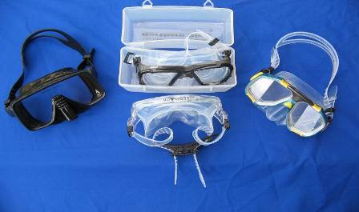
Masks
4 parts to a mask:
  Frame
  Strap
  Lens
  Body
Always test a new mask for fit
  Place against face without strap
  Inhale through nose
  Correctly fitted mask should
  remain in place until you exhale
Always wash in fresh water after use

Slide 6
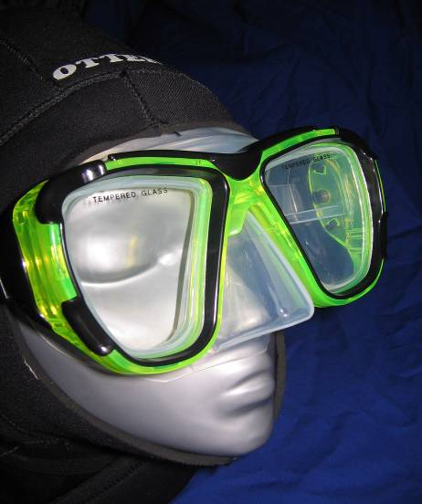
Masks
Mask seals to face under hood
Nose can be pinched over mask to blow air down the Eustachian tubes (Valsalva manoeuvre) in order to equalise ears
Most masks are constructed from silicon skirt and tempered glass
Mask volume can vary
© Dons Dive Store

Slide 7
Magnification and Colour
Magnification
  As light rays pass from water into the air space in a mask they are bent (refracted)
  This causes objects to appear about 33% larger and 25% closer to the viewer
Colour
  White light consists of many different colours of light
  Each colour is absorbed at a different depth
  Reds are the first to go, with only blue light reaching great depths
Sea Level
5
10
15
20
25
30
35
Reds
Oranges
Yellows
Greens
Blues
Greys
Depth in metres

Slide 8
Masks Clearing
Mask Demisting
  New masks normally have a oily film on the lens which must removed before use
  Many manufacturers recommend rubbing toothpaste over lens then washing off. Commercial cleaners also available
  Before diving you must demist your mask by spitting or a slice of raw potato into the inside and rubbing on the lens then wash out
Mask Clearing
  Flooded mask is cleared by first tilting the head back
  Gently press one hand on top edge of the mask then exhale through the nose
  This displaces water out of the mask
  More than one exhalation may be required
  Ensure a good seal on face to avoid leakage

Slide 9
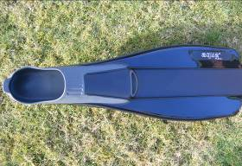
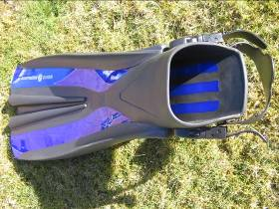
Fins
Fins are worn to propel the diver through the water using leg action alone, leaving the hands free
There are 2 basic types of fins
  Pool fins have a ‘shoe’ and can be worn with bare feet
  Open water fins are open ended and held in place with a strap designed to go over a boot
Blades should have graduated stiffness in order to transmit the power of the fining action of the feet and legs
© Dons Dive Store
Pool fin
Open Water fin
© Dons Dive Store

Slide 10
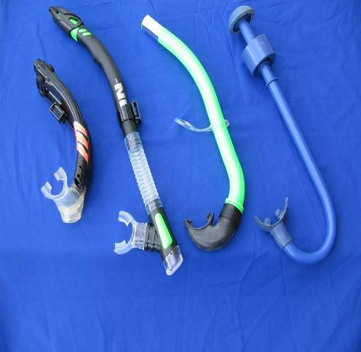
Snorkels
A snorkel allows the user to breathe whilst lying on the surface. This makes fining on the surface much easier
A snorkel consists of a mouthpiece and tube
Some snorkels also have drain valves to assist in clearing
Maintenance – always wash in fresh water after use
© Dons Dive Store

Slide 11
Snorkel Clearing
You may clear a snorkel in two ways:
  On returning to surface, blow out by the snorkel mouthpiece, clearing all the water from the snorkel tube. The diver may breathe without raising head from water
  As you approach the surface, look up and exhale into the snorkel tube. The air in the snorkel tube will expand and clear the water automatically if timed correctly. Place face back in the water and continue breathing from the snorkel tube
Use your pool training to develop these skills

Slide 12
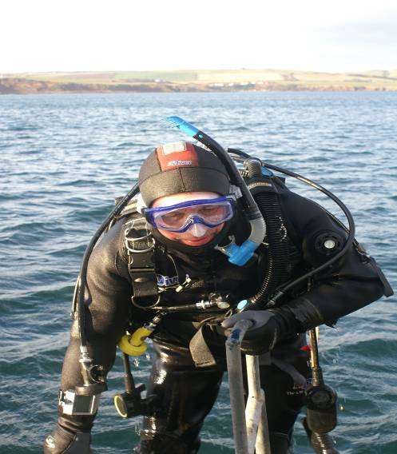
Basic Equipment
Snorkel is attached to the mask using a clip, or placed under the strap
Snorkel should be worn on the left as regulator is worn on right
© Dons Dive Store

Slide 13
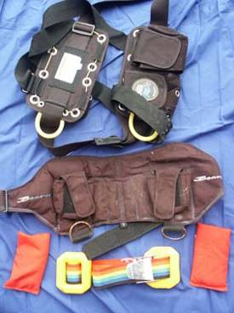
Weight Belts
A wetsuit or drysuit will increase a diver’s buoyancy, so a weight belt is needed to enable them to attain neutral buoyancy
There are a number of different weight systems available
A simple belt and buckle with
solid weights threaded
through the belt
A shot belt contains lead shot
loose or in pouches
A weight harness is strapped
over the shoulders, It contains
lead pouches which can be
dumped
All weight belts should have a
quick release buckle

Slide 14
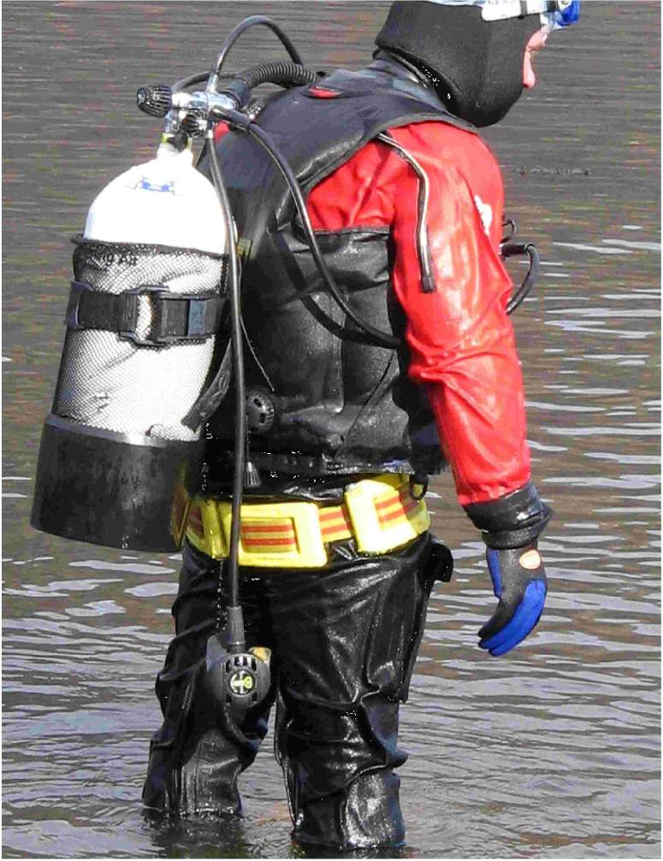
Adjustment of Weight Belt
During a dive, your weight belt may loosen off due to suit compression
This can lead to the belt slipping down your hips and is sometimes referred to as ‘trainee weight belt’
Loss of weight belt can lead to a buoyant ascent

Slide 15
Basic Signals
There are 3 methods of signalling underwater:
  hands
  rope
  torch
The main method of signalling is hand signals
  Ok signal - used both as question or answer
  Directional dive signals – e.g down, up, stop or direction
  Adversity signals – e.g no air, distress
  Information signals – e.g danger, something is wrong, you or me
  Additional information signals- e.g cold, narcosis, air?

Slide 16
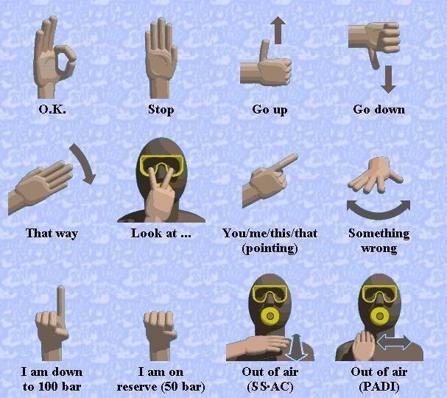
Basic Signals
Source;Craig Heath, Hertfordshire

Slide 17
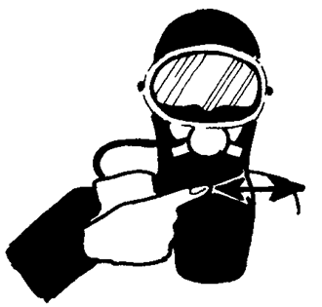
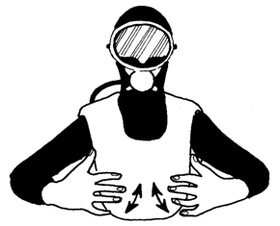
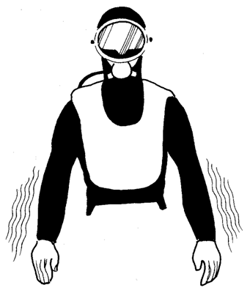
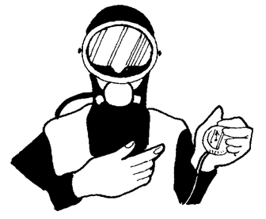
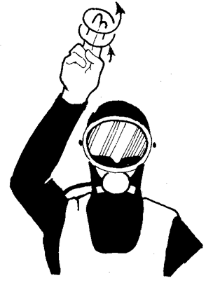
Other Signals
Danger Out of Breath I’m Cold
Show me your gauge I’m Narked

Slide 18
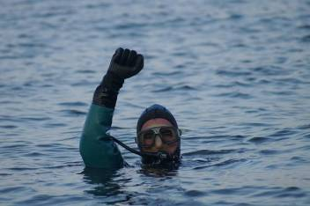
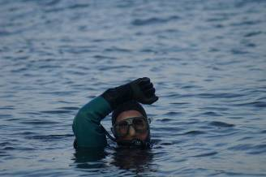
More signals
Adversity Signals - I’m in distress ( on the surface)

Slide 19
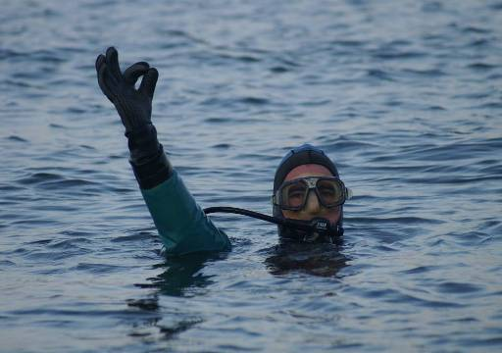
Surfacing Procedures
At the end of a dive, surface should be approached in a smooth and controlled manner, looking upwards with arm outstretched giving the OK signal
Listen for boat engines, making a 360º turn prior to surfacing
Always be prepared to descend below the water again to avoid collision with boats under sail
© Dons Dive Store

Slide 20
Summary
Basic Equipment
Basic Signals
Surfacing Procedures
Relying on your basic equipment and signals may save your life

Slide 21
The End
Thank you for your attention
Any questions?

Slide 22
Please provide any feedback on these slides to hq@scotsac.com
Thanks.

